Slide 1
مشکلات اسفنکتری روده و مثانه بعد از سکته مغزی
دکتر مهدی فرهودی
استاد نورولوژی
فلوشیپ سکته مغزی

Slide 2
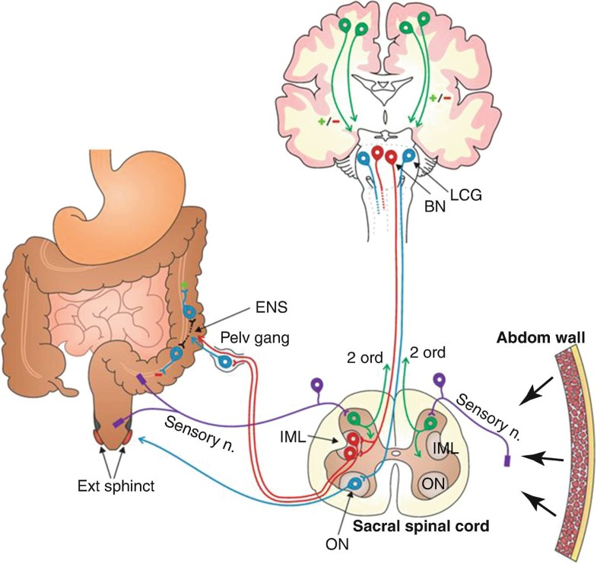
Introduction: Physiology of Continence

Slide 3
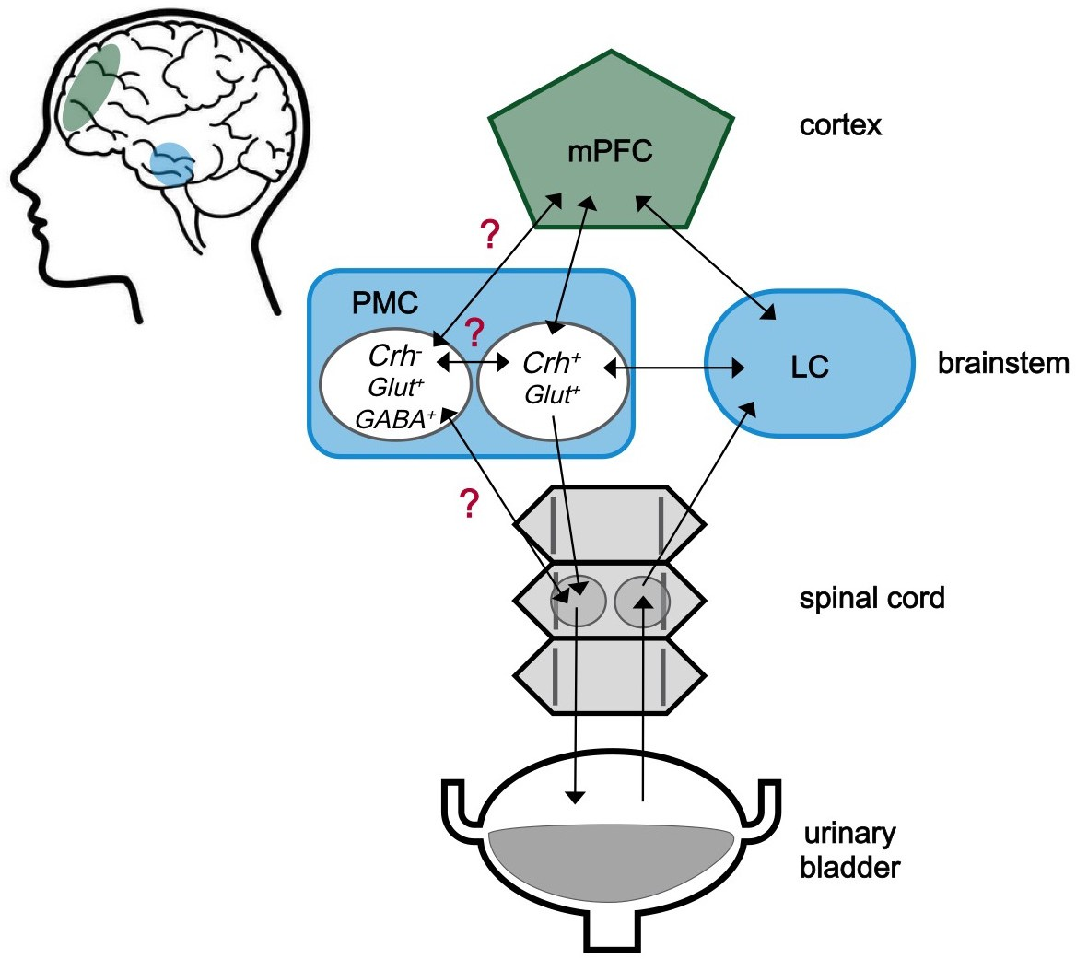

Slide 5
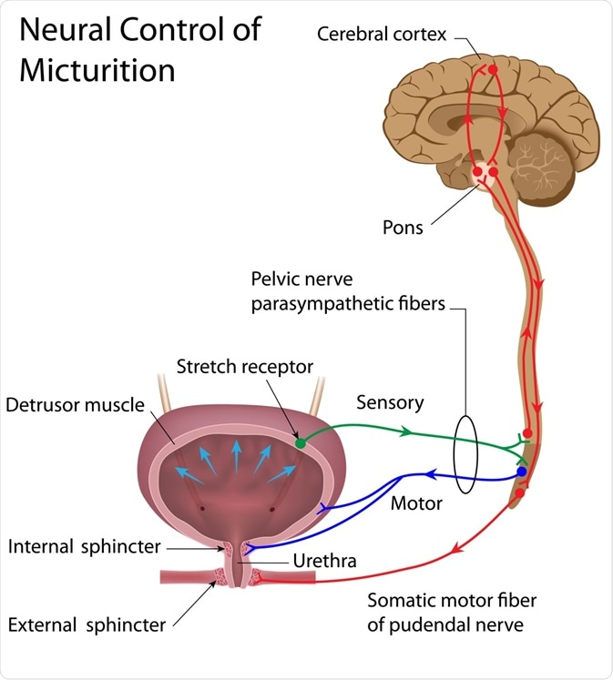
Frontal & internal capsule lesion:
Hyperactive bladder or uninhibited sphincter relaxation.
Putaminal lesion:
Hyperactive bladder with usually normal sphincter function.
Pontine Micturition Center

Slide 6
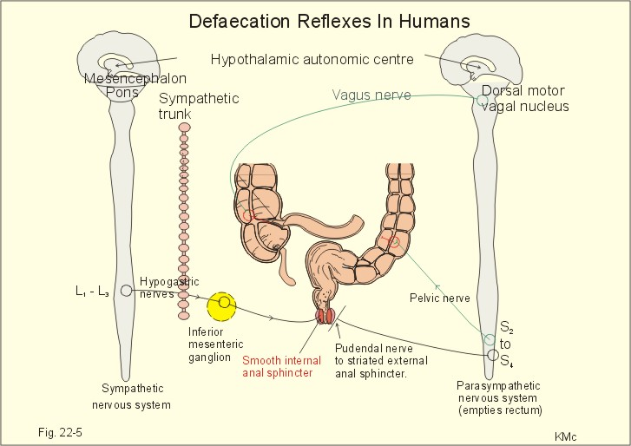

Slide 7
Design:
Retrospective study, eighty-two with recent stroke patients (42 women and 40 men; mean age, 65.5y) were included. Conclusions:
IBE is common among patients with stroke and is caused by decreased detrusor contractility or detrusor-external sphincter dyssynergia (DESD). Spasticity of the external urethral sphincter is a possible pathophysiologic mechanism of DESD.
Notes:
Objectives: To delineate the frequency, clinical risk factors, and urodynamic mechanisms of incomplete bladder emptying (IBE) among patients with recent stroke. Design: Retrospective study. Setting: Inpatient setting in the rehabilitation ward of a university hospital. Participants: All patients with acute stroke admitted for rehabilitation between January and December 2005, excluding those with a history of lower-urinary tract symptoms and urologic diseases. Eighty-two patients (42 women and 40 men; mean age, 65.5y) were included. Interventions: Not applicable. Main Outcome Measures: We measured postvoid residual (PVRs) by catheterization or by using an ultrasonic bladder scanner. Twenty-five patients (30.5%) had IBE with PVRs greater than 100mL on 2 consecutive days. Patients with IBE were evaluated by a urologist and subsequently underwent urodynamic studies. Results: The presence of IBE was significantly associated with urinary tract infection (P.001) and aphasia (P.046). The presence of IBE was not related to sex, stroke location, nature of stroke (hemorrhagic or ischemic), history of diabetes mellitus, or previous stroke. Urodynamic studies done on 22 patients with IBE revealed acontractile detrusor in 8 patients (36%) and detrusor underactivity in 3 (14%). Eleven patients (50%) had detrusor-external sphincter dyssynergia (DESD) combined with normative detrusor function (5 patients) or detrusor hyperactivity (6 patients); all but 1 of these patients had a supratentorial lesion. The presence of DESD was associated with a longer onset-to-evaluation interval (P.008) and spasticity of the stroke-affected lower limb (P.002). Diabetes mellitus was associated with the presence of acontractile detrusor or detrusor underactivity (P.03). Conclusions: IBE is common among patients with stroke and is caused by decreased detrusor contractility or DESD. Spasticity of the external urethral sphincter is a possible pathophysiologic mechanism of DESD.

Slide 8
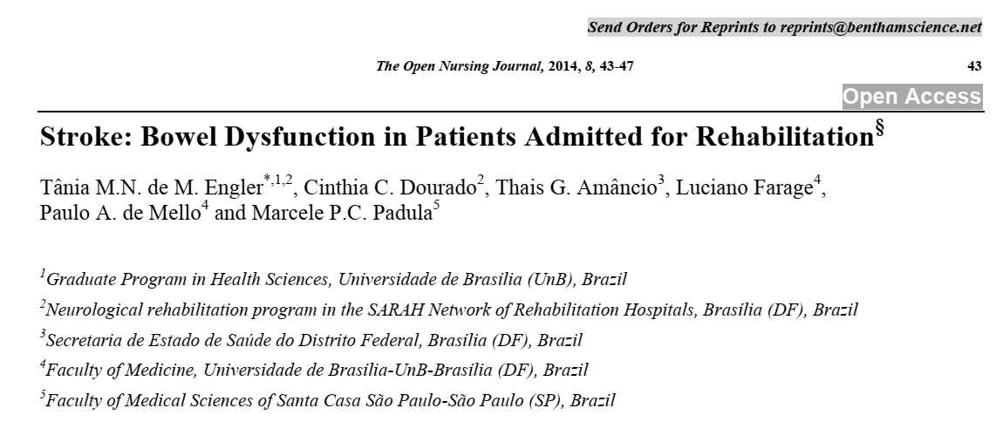

Slide 9
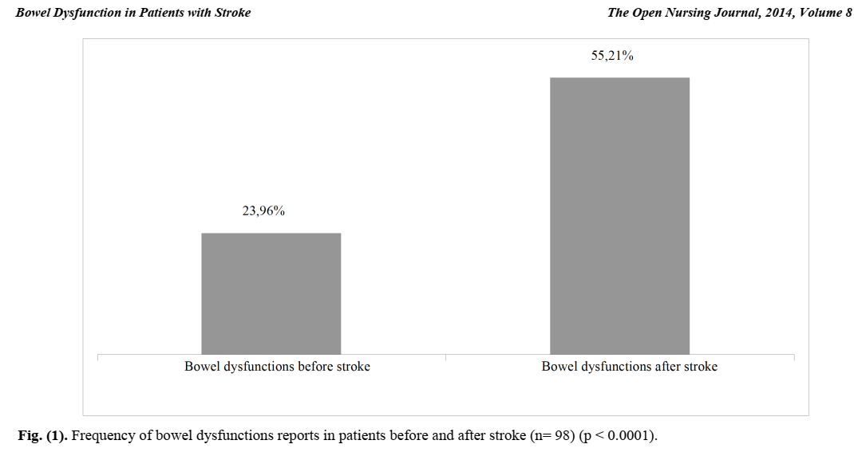

Slide 10
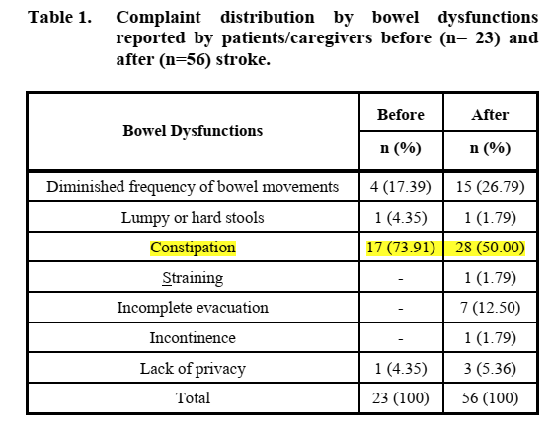

Slide 13
Facts of Incontinence & Stroke
About half of people admitted to hospital with a stroke will have lost control of their bladder, and a third will experience loss of bowel control.
It is quite normal for incontinence to be a source of concern after a stroke.
For many people loss of toilet control is a very sensitive and personal issue and some people may feel like they have lost their dignity.
However, there is a lot that can be done to help, and just 15 per cent of stroke survivors will continue to have continence problems a year after their stroke.
It is generally easier to regain bowel control than bladder control.
Regaining control can improve both the morale and overall recovery.

Slide 14
Why do continence problems develop?
Not fully conscious
Difficulty walking
Communication difficulties
Being less mobile: more prone to constipation
Some medicines, including ones commonly prescribed after a stroke, may affect bladder or bowel control.
Bladder infections
Aggravation of past continence problems

Slide 15
Which continence problems can occur after stroke? Urine problems:
Frequency
Urgency – feeling a sudden, urgent and uncontrollable need to pass urine. This is due to bladder contractions.
Nocturnal incontinence
Functional incontinence – caused when the physical effects of a stroke impede mobility or make it difficult to unfasten clothes in time to use the toilet.
Stress incontinence – small amounts of urinary leakage on coughing, sneezing or laughing.
Reflex incontinence – passing urine without realizing it.
Overflow incontinence – where the bladder leaks due to being too full. This can be due to a loss of feeling in the bladder, or difficulty in emptying bladder effectively (urine retention).
Notes:
Frequency
Urgency – feeling a sudden, urgent and uncontrollable need to pass urine. This is due to bladder contractions.
Nocturnal incontinence
Functional incontinence – caused when the physical effects of a stroke impede mobility or make it difficult to unfasten clothes in time to use the toilet.
Stress incontinence – small amounts of urinary leakage on coughing, sneezing or laughing. This usually happens because the muscles in the pelvic floor or urethral sphincter are weak or damaged.
Reflex incontinence – passing urine without realizing it. This happens when a stroke has affected the part of the brain that senses and controls bladder movement.
Overflow incontinence – where the bladder leaks due to being too full. This can be due to a loss of feeling in your bladder, or difficulty in emptying your bladder effectively (urine retention)

Slide 16
Which continence problems can occur after stroke? Bowel problems:
Fecal incontinence – or uncontrolled bowel movement. This can be caused by damage to the part of the brain controlling the bowel, not being able to get to the toilet in time, diarrhea or constipation.
Constipation with overflow – large stools can get stuck and block the bowel. Liquid stools above the blockage can flow around it causing watery stools to leak.
Fecal impaction – dry and hardened stools collect in the rectum, they can press on the bladder and make any problems with emptying your bladder worse.

Slide 17
Initial care after stroke
Until start actively regaining control of the bladder or bowel, need to wear incontinence pads.
If there is good bladder and bowel function but are unable to indicate when you need the toilet, the nurses may offer the toilet or commode every two hours or so.
While in bed, may be transferred to the commode using a hoist, or offered a bottle or urinal sheath or a bedpan.
If the bladder is not emptying completely, then a catheter may be used to empty it. This may need to be done several times a day to keep you comfortable and reduce the risk of UTI.
If develops soreness through skin contact with urine, or the catheterization causes discomfort, an indwelling (or semi-permanent) catheter may be used.
Fecal containment bags are used in intensive care, but it is more likely to wear pads in SCU.
Good hygiene and skin care are therefore important to protect skin from damage.
Notes:
Until being well enough to start actively regaining control of the bladder or bowel, may need to wear incontinence pads.
These should be changed rapidly by the nursing staff if they become soiled. If you have good bladder and bowel function but are unable to indicate when you need the toilet, the nurses may offer you the toilet or commode every two hours or so. While you are in bed, you may be transferred to the commode چارپایه زیر مستراح دستی using a hoist بالابر, or offered a bottle or sheath urinal (designed for men) or a bedpan (for women).
If your bladder is not emptying completely, then a catheter may be used to empty it. This involves gently inserting a fine tube to drain urine from the bladder into a bag. This may need to be done several times a day (intermittent catheterization) to keep you comfortable and reduce the risk of developing a urinary tract infection (UTI).
If you develop soreness through skin contact with your urine, or the catheterization causes discomfort, an indwelling (or semi-permanent) catheter may be used.
Fecal containment bags are used in intensive care, but you are more likely to wear pads if you are on a stroke unit. Good hygiene and skin care are therefore important to protect your skin from damage.

Slide 18
Assessment
Assessment to establish the nature and cause of the difficulties and devise an effective treatment program.
The continence assessment may include:
A medical history of any problems you had before the stroke and your current medication that could be affecting control
A simple chart recording your fluid intake and output over at least two days
A urine sample analysis to rule out infections
A chart recording bowel movements and consistency
Further tests ranging from a simple PE to bladder ultrasound scan, abdominal x-ray or specialist investigations to determine exactly how your bladder and bowel are working.

Slide 19
What are the treatment bladder incontinence?
Bladder training which reduces urgency and frequency by gradually retraining your bladder to be less active and to hold more urine. This is done by making regular visits to the toilet, and gradually extending the time between visits until the bladder learns how to ‘hold on’.
Pelvic floor exercises ( Kegel exercises) help strengthen muscles so that they provide support. This will help improve bladder control and improve or stop leakage of urine.
Bladder stimulation vibrating devices are sometimes effective where there is difficulty in emptying the bladder.
Medication may help to reduce urine production, urgency and frequency.
Weight loss (if overweight) will often improve bladder control in the longer term.

Slide 21
What are the treatments for bowel incontinence?
• Bowel training through regular visits to the toilet (usually after meals, when the bowels are stimulated to move by a natural reflex) and gradually learning to delay bowel movements once on the toilet to improve the ability to ‘hold on’. • Medication to help reduce movement in the bowel or make the sphincter muscle tighter to avoid ‘leakage’. • Treatment for constipation using laxatives. • A bowel regimen which uses medicine to make constipation followed by an enema… • Dietary changes such as eating more fiber if you have constipation and eating less fiber if you have diarrhea.

Slide 22
Which professionals can help?
Continence advisers / Continence clinic.
Specialist consultant: urologist, gastroenterologist, gynecologist or geriatrician.
Physiotherapists
Occupational therapists
Speech and language therapists
Dietitians
Social workers

Slide 23
Living with ongoing incontinence
Incontinence can be managed discreetly as part of daily living.
There are various continence products available. These include high-absorbency pads and pull ups, with a built-in ‘hydrophobic’ layer for skin protection.
Absorbent, washable seat pads can be used to protect your furniture and are made in a range of colors.
Mattress protectors and absorbent bed pads with tuck-in flaps (known as draw sheets) will reduce how often you need to change your bedding.
A commode is like a chair with a removable potty under the seat, and can be useful to have in the bedroom, especially at night.
Notes:
Incontinence can be managed discreetly as part of daily living.
There are various continence products available. These include high-absorbency pads and pull ups, with a built-in ‘hydrophobic’ layer for skin protection.
Absorbent, washable seat pads can be used to protect your furniture and are made in a range of colors. Mattress protectors and absorbent bed pads with tuck-in flaps (known as draw sheets) will reduce how often you need to change your bedding. A commode is like a chair with a removable potty under the seat, and can be useful to have in the bedroom, especially at night. You may be able to obtain a commode through your local social services. Otherwise they are available from specialist suppliers or to order from retailers such as Boots.
Practical measures like planning access to toilets, when you are out, and having a change of clothing and hygiene kit with you (which might include plastic bags for disposal or laundry, soap and flannel, antibacterial wet wipes and latex gloves) will help you manage in any situation. The National Key Scheme (NKS), or Royal Association for Disability Rights (RADAR) Scheme, provides keys to public disabled toilets designed for wheelchair access. The scheme is available to people with disabilities or health conditions seriously affecting their continence. If you are eligible your council may provide a key free of charge. See ‘Useful organisations’ section.
A daily routine of regular visits to the toilet, and reducing the amount you drink before bed time, will help to avoid accidents. An alarm can be used to schedule a visit to the toilet during the night, or you may prefer to try a moisture alarm on your bed, which will sound when wetness is detected. This is designed to wake you up so that you can finish emptying your bladder in the toilet. You may wish to wear a silent vibrating alarm watch, which can be set to give a discreet reminder at regular intervals. A silent alarm also has advantages at night time, if you wish to avoid disturbing others.

Slide 24
Living with ongoing incontinence
Practical measures like planning access to toilets, when you are out, and having a change of clothing and hygiene kit with you (which might include plastic bags for disposal or laundry, soap and flannel, antibacterial wet wipes and latex gloves) will help you manage in any situation.
The National Key Scheme (NKS), or Royal Association for Disability Rights (RADAR) Scheme, provides keys to public disabled toilets designed for wheelchair access. The scheme is available to people with disabilities or health conditions seriously affecting their continence. If you are eligible your council may provide a key free of charge.
A daily routine of regular visits to the toilet, and reducing the amount you drink before bed time, will help to avoid accidents.
An alarm can be used to schedule a visit to the toilet during the night, or you may prefer to try a moisture alarm on your bed, which will sound when wetness is detected. This is designed to wake you up so that you can finish emptying your bladder in the toilet. You may wish to wear a silent vibrating alarm watch, which can be set to give a discreet reminder at regular intervals.
Notes:
incontinence can be managed discreetly as part of daily living.
There are various continence products available. These include high-absorbency pads and pull ups, with a built-in ‘hydrophobic’ layer for skin protection.
Absorbent, washable seat pads can be used to protect your furniture and are made in a range of colors. Mattress protectors and absorbent bed pads with tuck-in flaps (known as draw sheets) will reduce how often you need to change your bedding. A commode is like a chair with a removable potty under the seat, and can be useful to have in the bedroom, especially at night. You may be able to obtain a commode through your local social services. Otherwise they are available from specialist suppliers or to order from retailers such as Boots.
Practical measures like planning access to toilets, when you are out, and having a change of clothing and hygiene kit with you (which might include plastic bags for disposal or laundry, soap and flannel, antibacterial wet wipes and latex gloves) will help you manage in any situation. The National Key Scheme (NKS), or Royal Association for Disability Rights (RADAR) Scheme, provides keys to public disabled toilets designed for wheelchair access. The scheme is available to people with disabilities or health conditions seriously affecting their continence. If you are eligible your council may provide a key free of charge. See ‘Useful organisations’ section.
A daily routine of regular visits to the toilet, and reducing the amount you drink before bed time, will help to avoid accidents. An alarm can be used to schedule a visit to the toilet during the night, or you may prefer to try a moisture alarm on your bed, which will sound when wetness is detected. This is designed to wake you up so that you can finish emptying your bladder in the toilet. You may wish to wear a silent vibrating alarm watch, which can be set to give a discreet reminder at regular intervals. A silent alarm also has advantages at night time, if you wish to avoid disturbing others.

Slide 25
Living with ongoing incontinence
Specialized products such as catheters, anal plugs, urine drainage bags and appliances for men can be available.
Careful hygiene and skin care around the affected area are needed to avoid the risk of dermatitis. If your skin is badly affected, an ‘indwelling’ catheter, in which the bag is attached to the leg and worn under clothing, may be recommended, though this is generally used as a last resort.
In some cases a supra-pubic catheter may prove a more convenient method of permanent drainage.
Notes:
Specialised products such as catheters, anal plugs, urine drainage bags and appliances for men can be obtained on prescription from your GP. In Scotland pads are also available on prescription. Normal prescription charges and exemptions apply. Washable or disposable waterproof bed and seat covers are generally not provided by the NHS. Products can also be purchased from some pharmacies and by mail order or online. If you buy products from a chemist or by mail order, they can give you a form to sign so you do not pay VAT. The moisture, friction and bacteria associated with incontinence can cause skin rashes and infection. Careful hygiene and skin care around the affected area are needed to avoid the risk of dermatitis (inflammation of the skin). If your skin is badly affected, an ‘indwelling’ catheter, in which the bag is attached to the leg and worn under clothing, may be recommended, though this is generally used as a last resort. In some cases a supra-pubic catheter, where the catheter is inserted into the bladder through the abdomen wall, may prove a more convenient method of permanent drainage. Your continence adviser should be able to advise you in detail about these procedures.

Slide 26
General help guide for Incontinency
Adopt a routine to help avoid accidents.
Remember to follow all the tips and exercises your physiotherapist has given you – it takes time for the effects to show.
Drink plenty of fluids during the day especially water. This will help to avoid infections of the bladder and also constipation. Try to have 6-8 glasses of fluid each day, and more if you have a catheter.
Cut down on drinks with caffeine eg. tea, coffee and cola, and alcoholic drinks, as they can irritate the bladder.
Follow a balanced diet with plenty of fruits and vegetables.
Keep as active as you can. This will help stimulate the bowel to move regularly.
Try to use the toilet as soon as you need to, and empty your bladder fully.
Wear clothes that are easier to unfasten.
Take care of your skin by using mild soap or specialised products and take care to cleanse and dry thoroughly.
Dispose of incontinence materials safely.
Notes:
Helping yourself • Adopt a routine (as outlined above) to help avoid accidents. • Remember to follow all the tips and exercises your physiotherapist has given you – it takes time for the effects to show (and to be maintained). • Drink plenty of fluids during the day especially water. This will help to avoid infections of the bladder and also constipation. Try to have 6-8 glasses of fluid each day, and more if you have a catheter.
Cut down on drinks which caffeine such as tea, coffee and cola, and alcoholic drinks, as they can irritate the bladder. • Follow a balanced diet with plenty of fruits and vegetables. They contain valuable fibre, which helps bowel movements. • Keep as active as you can. This will help stimulate the bowel to move regularly. • Try to use the toilet as soon as you need to, and empty your bladder fully. This can also help to avoid infections. • Wear clothes that are easier to unfasten, for example with Velcro or elasticated waistbands instead of buttons or fiddly fasteners. • Take care of your skin by using mild soap or specialised products and take care to cleanse and dry thoroughly. • Dispose of incontinence materials safely. Ensure that disposal bags are secure and leak-proof and use a bin with a lid.

Slide 27
